Slide 1
Ada Boost Regressor

Slide 2
AdaBoostRegressor is a machine learning algorithm that is used for regression problems.
It is an ensemble method that combines multiple weak models (i.e., models with low predictive power) to create a strong model with high predictive power.
This can be achieved by adjusting the weights to each training instance based on its error of the current prediction.
What is AdaBoostRegressor

Slide 3
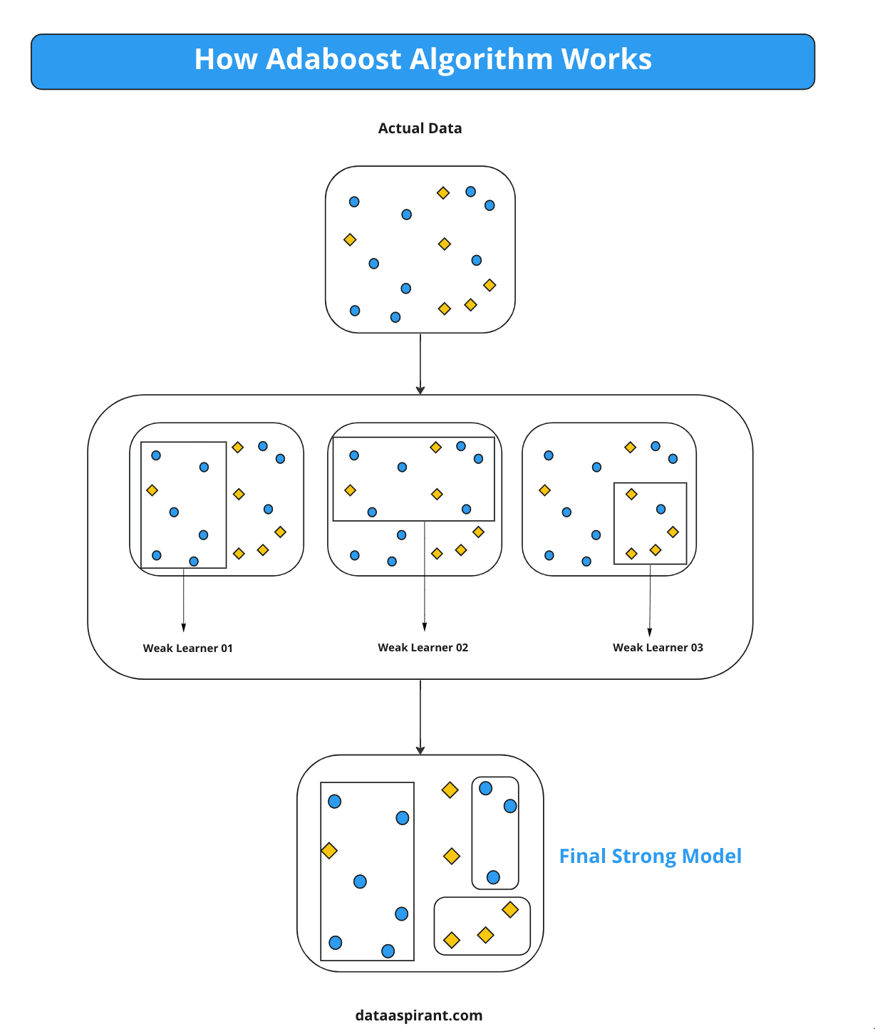
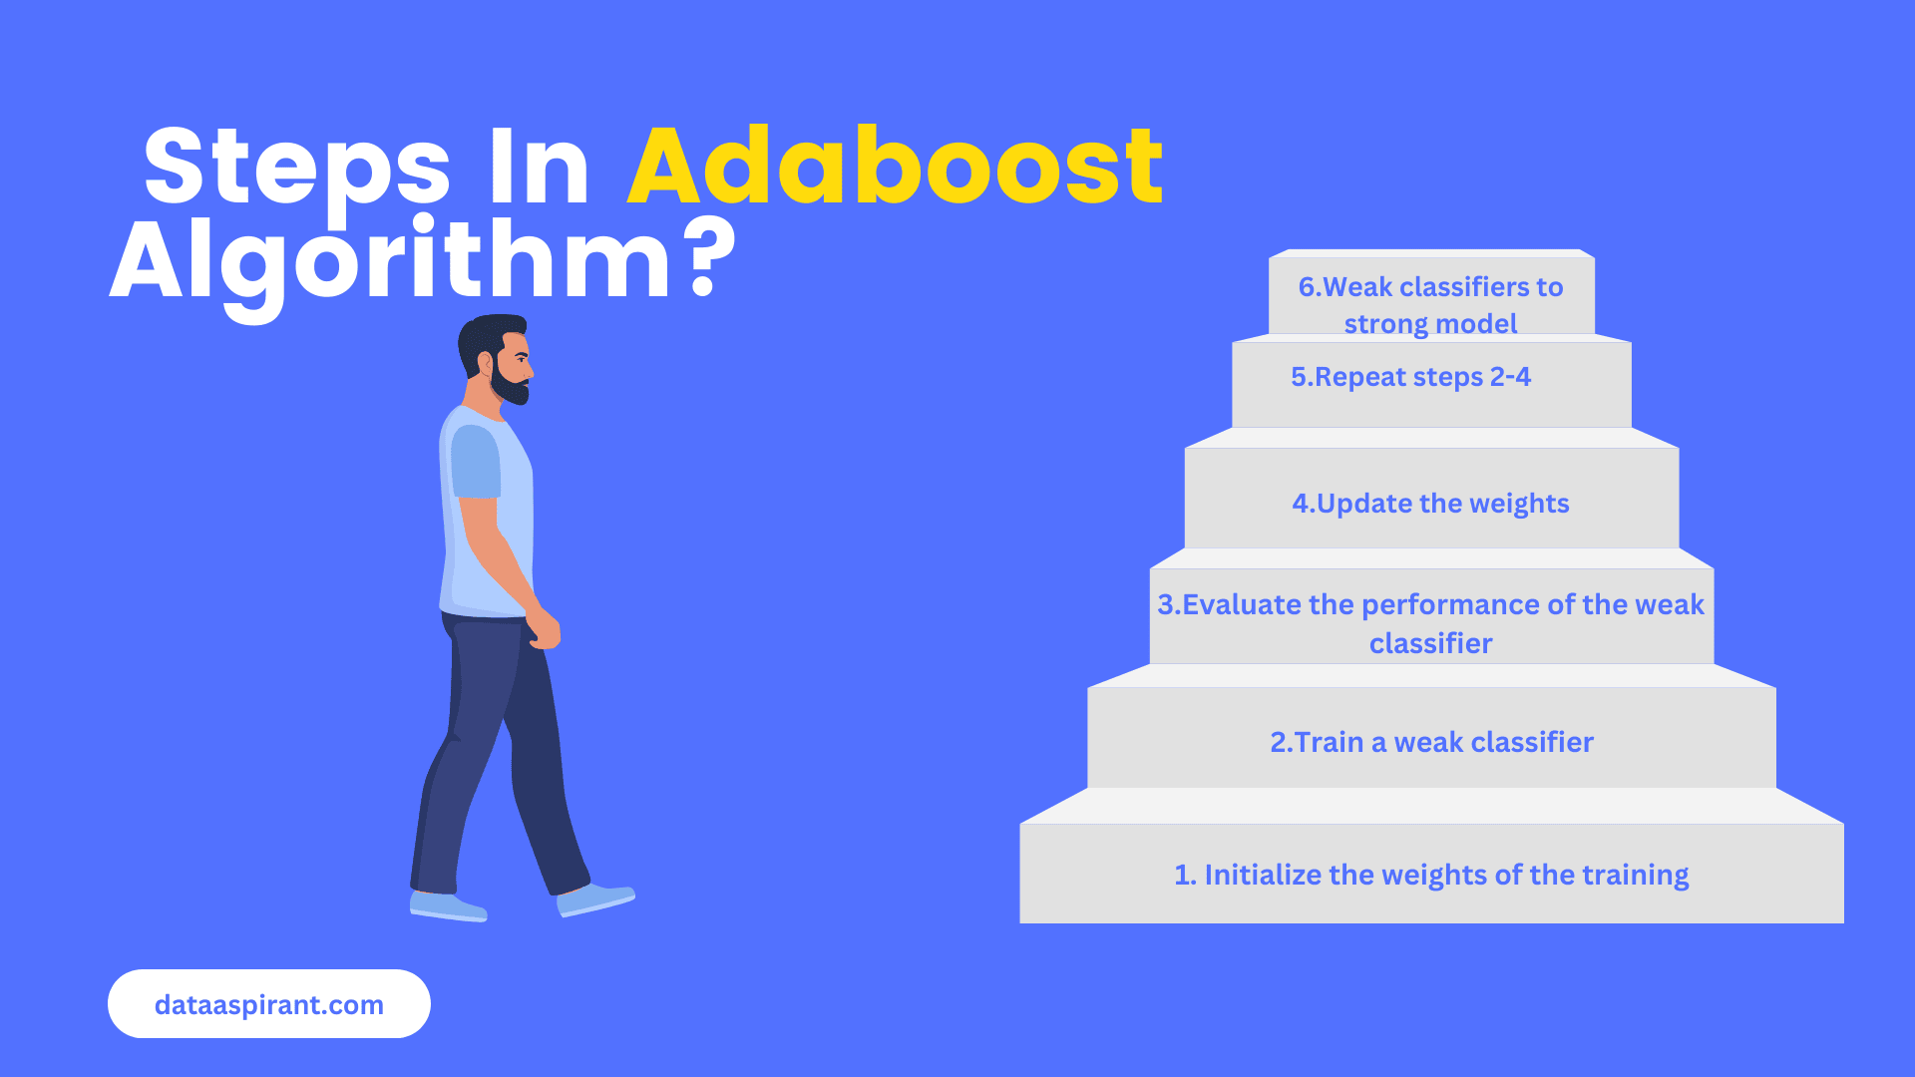

Slide 4
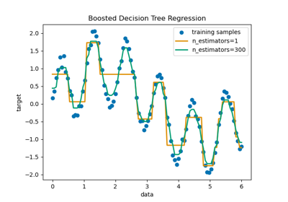
Example - Decision Tree Regression with AdaBoost

Slide 5
Advantage of AdaBoostRegressor
Often achieves high accuracy by combining multiple weak models.
The biggest advantage of this algorithm is its ability to handle noisy data and outliers.
It is also less prone to overfitting than other algorithms such as Support Vector Machines (SVM).

